Slide 1
Chapter 3
Information Systems Development Life Cycle

Slide 2
SDLC (waterfall model)
Feasibility study
System investigation
Systems analysis
Systems design
Implementation
Review and maintenance

Slide 3
Feasible:
Legally
Organisationally and socially
Technically
Economically

Slide 4
Systems Investigation
The functional requirements of the existing system (if there is one) and whether these requirements are being achieved
The requirements of the new system as there may be new situations or opportunities which suggest altered requirements
Any constraints imposed
The range of data types and volumes which have to be processed
Exception conditions
Problems of the present working methods

Slide 5
Systems Investigation
Observation
Interviewing
Questionnaires
Searching records and documentation
Sampling

Slide 6
Systems Analysis
Why do the problems exist?
Why were certain methods of work adopted?
Are there alternative methods?
What are the likely growth rates of data?

Slide 7
Systems Design
Input data and how the data is to be captured (entered in the system)
Outputs of the system
Processes, many carried out by computer programs, involved in converting the inputs to the outputs
Structure of the computer and manual files which might be referenced in the system
Security and back-up provisions to be made
Systems testing and implementation plans

Slide 8
Implementation
Code and test programs
Purchase hardware and software
Quality control
Training and education
Operations and user manuals
Security procedures
Cutover and acceptance testing

Slide 9
Review and Maintenance
Report
Organizational learning

Slide 10
IS Development Methodology
phases
techniques
tools
training
philosophy

Slide 11
IS Development Methodology
Flowcharts
An organisation chart, showing the reporting structure of people in a company or department
Manual document specifications
Grid charts
Discussion records
File and record specifications

Slide 12
Potential weaknesses of the SDLC
Failure to meet the needs of management
Instability
Inflexibility
User dissatisfaction
Problems with documentation
Lack of control
Incomplete systems
Application backlog
Maintenance workload
Problems with the ‘ideal’ approach
Emphasis on ‘hard’ thinking
Assumption of ‘green-field’ development

Slide 13
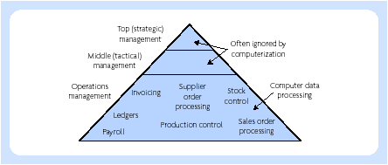
Failure to meet all the needs of management

Slide 14
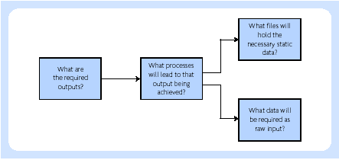
Design is output-driven

Slide 15
Recurring problems in ISD
Meeting project deadlines
System maintenance
Staff recruitment and retention
General user dissatisfaction
Changing requirements

